Slide 1
Creating Raster Layers for Soil Depth Ranges
Using gSSURGO Databases

Slide 2
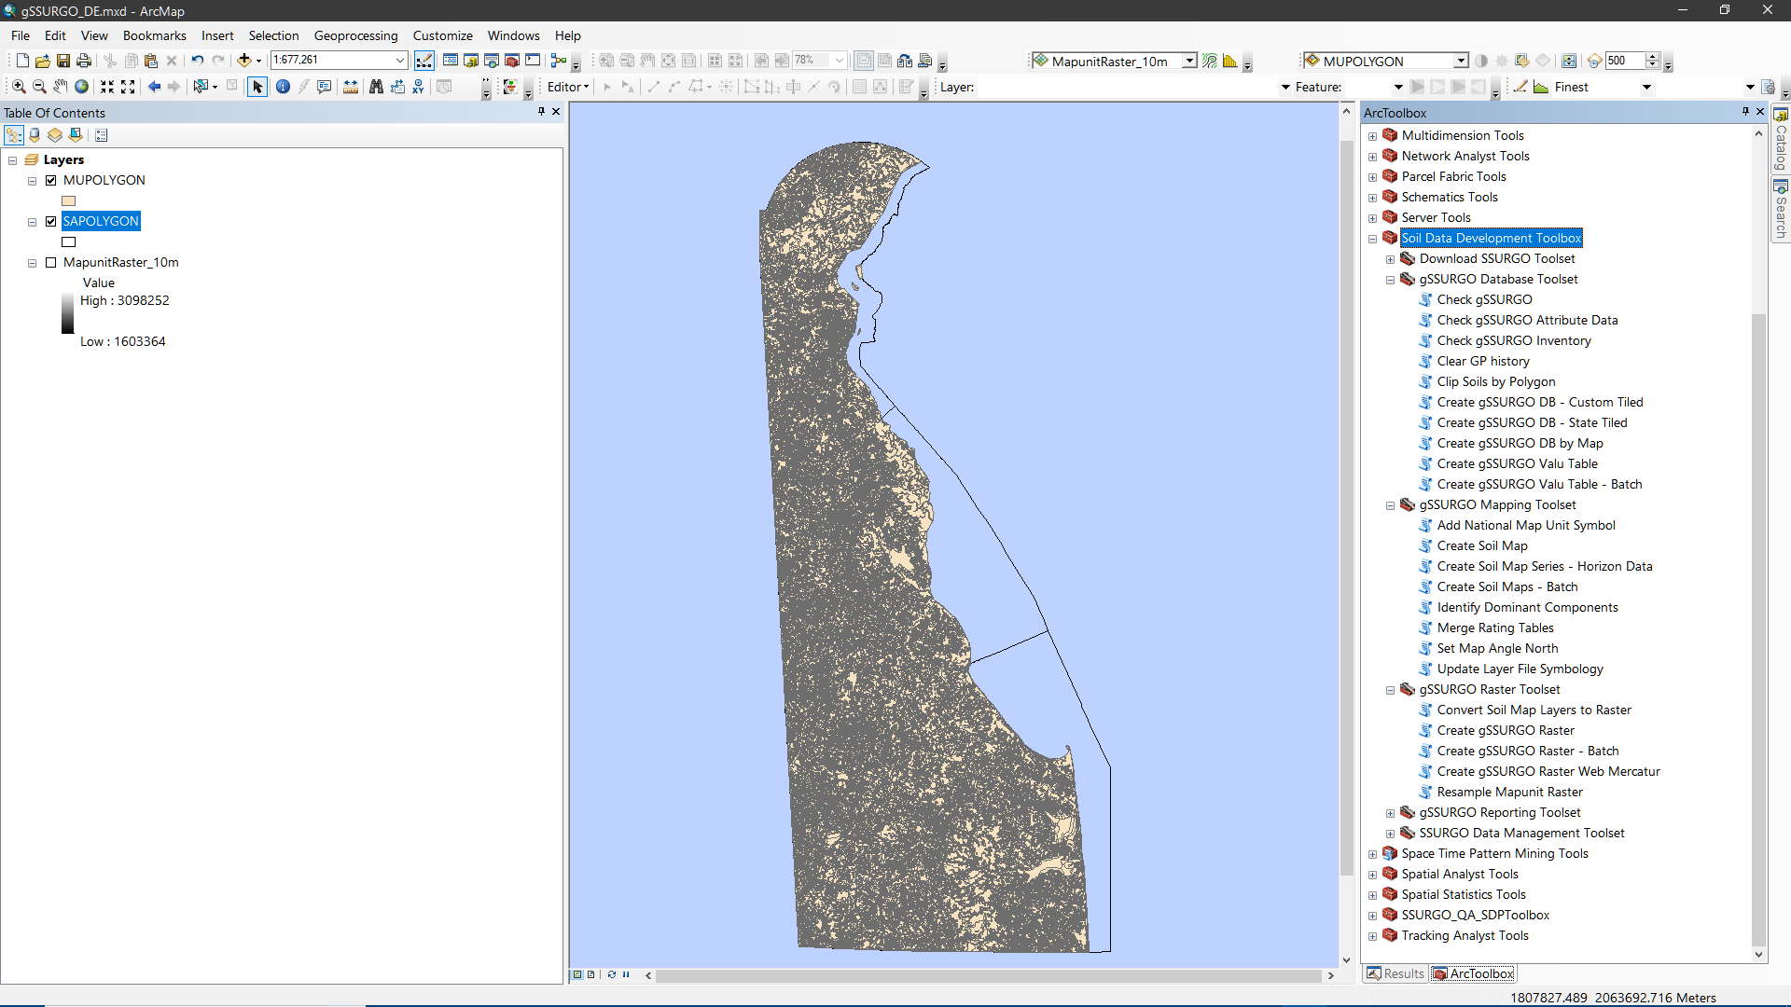
Begin with ArcMap, Soil Data Development Toolbox and gSSURGO…

Slide 3
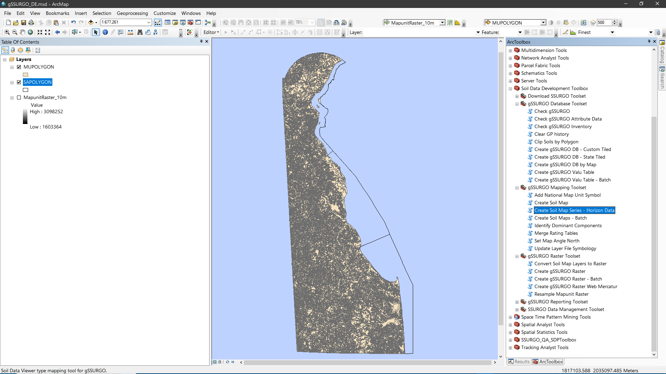
Open the ‘Create Soil Map Series – Horizon Data’ tool…

Slide 4
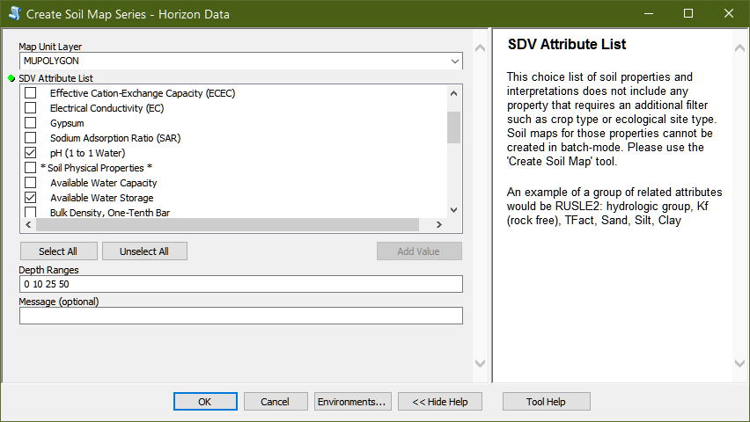
Select one or more horizon soil properties and enter a space-delimited list of horizon depths…
The vector MUPOLYGON featureclass is used to generate the initial map layers.

Slide 5
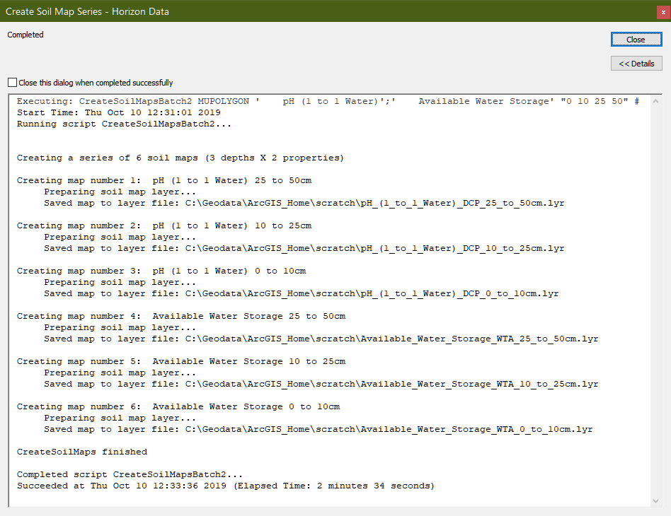

Slide 6
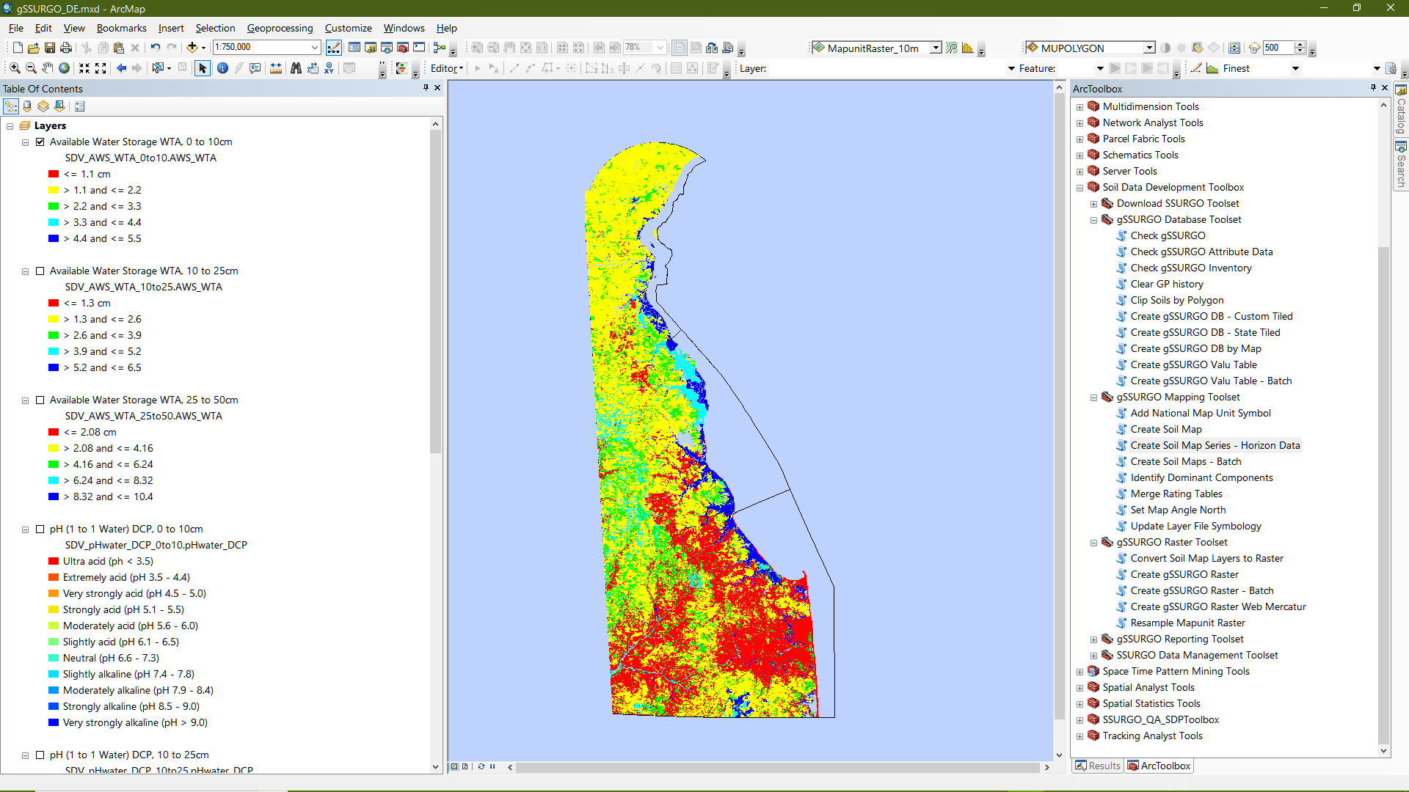
The vector soil map layers are added to the ArcMap table of contents

Slide 7
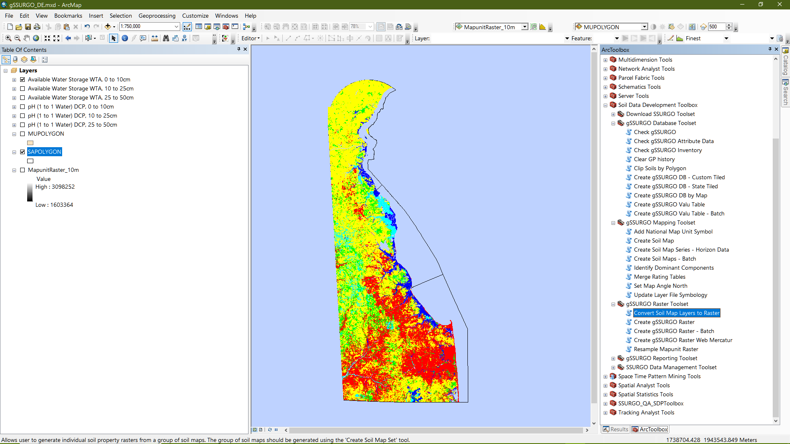
Next, open the ‘Convert Soil Map Layers to Raster’ tool…

Slide 8
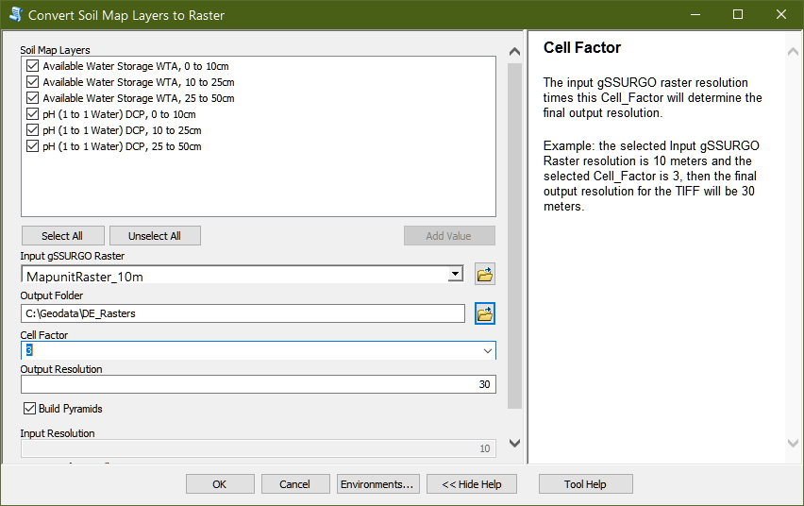
Select one or more map layers to convert to TIFF rasters and set the Cell_Factor parameter.

Slide 9
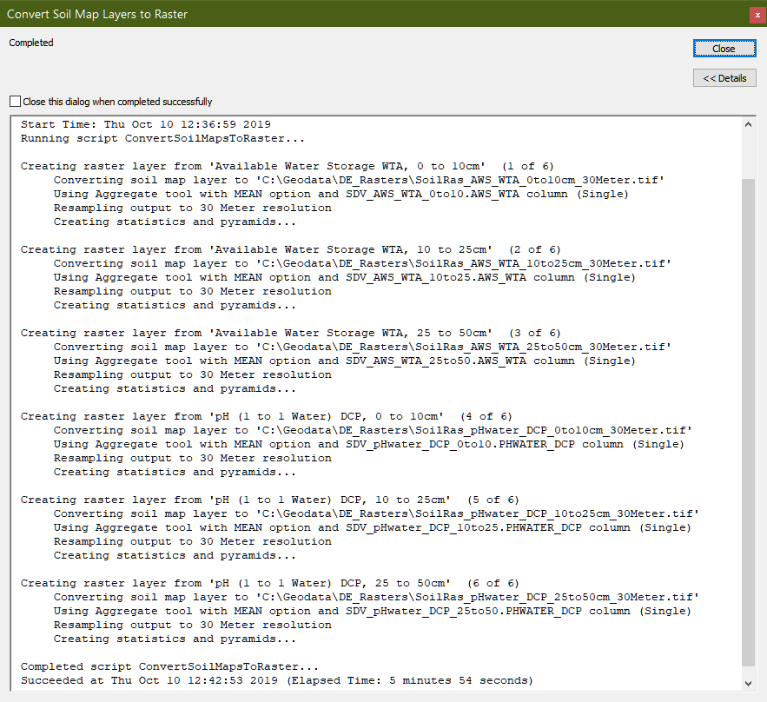

Slide 10
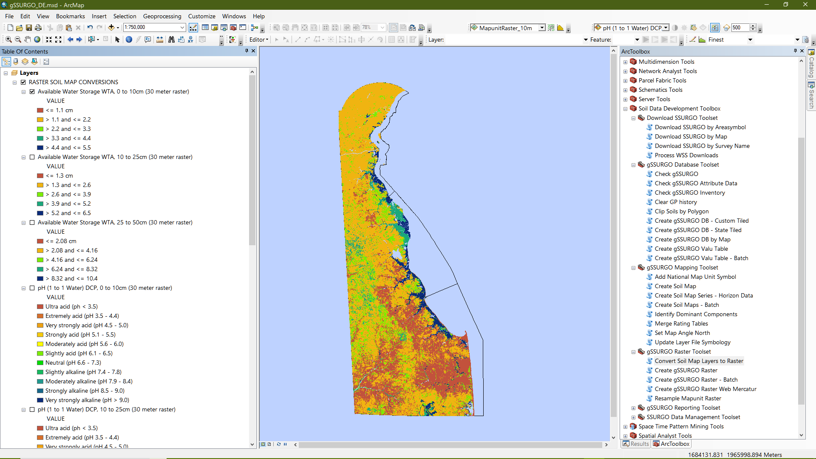
The output TIFF rasters are added to a group layer named ‘RASTER SOIL MAP CONVERSIONS’…

